Slide 1
On Becoming an Expert…
Rutger de Jong, Subject Librarian Science | BSc MI

Slide 2
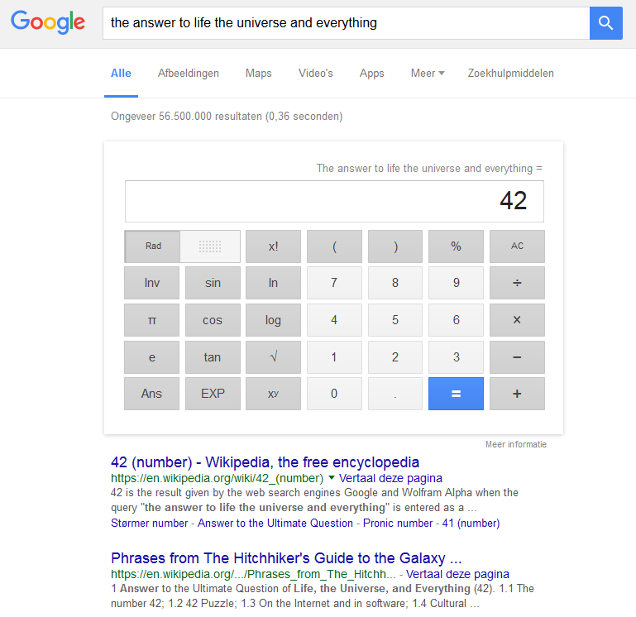
Question
Does Google really know everything?
Yes
No

Slide 3
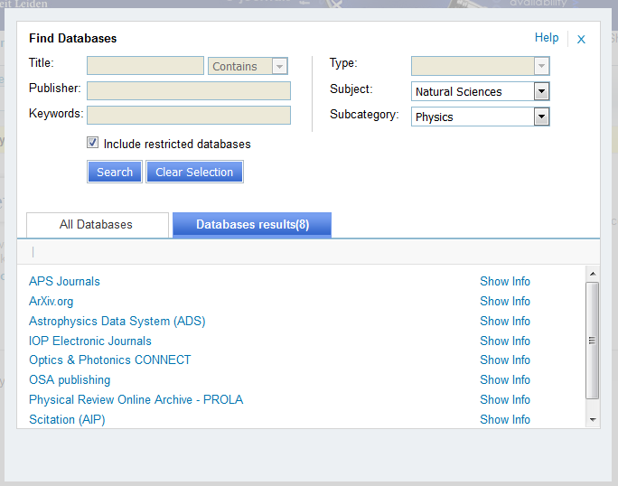
Question
If Google knew everything, would I still need Web of Science and other databases?
Yes
No

Slide 4
Question
The book or article I need is not in the library. Can I still get it legally?
Yes
No
Tina Chambers/ Dorling Kindersley / Universal Images Group

Slide 5
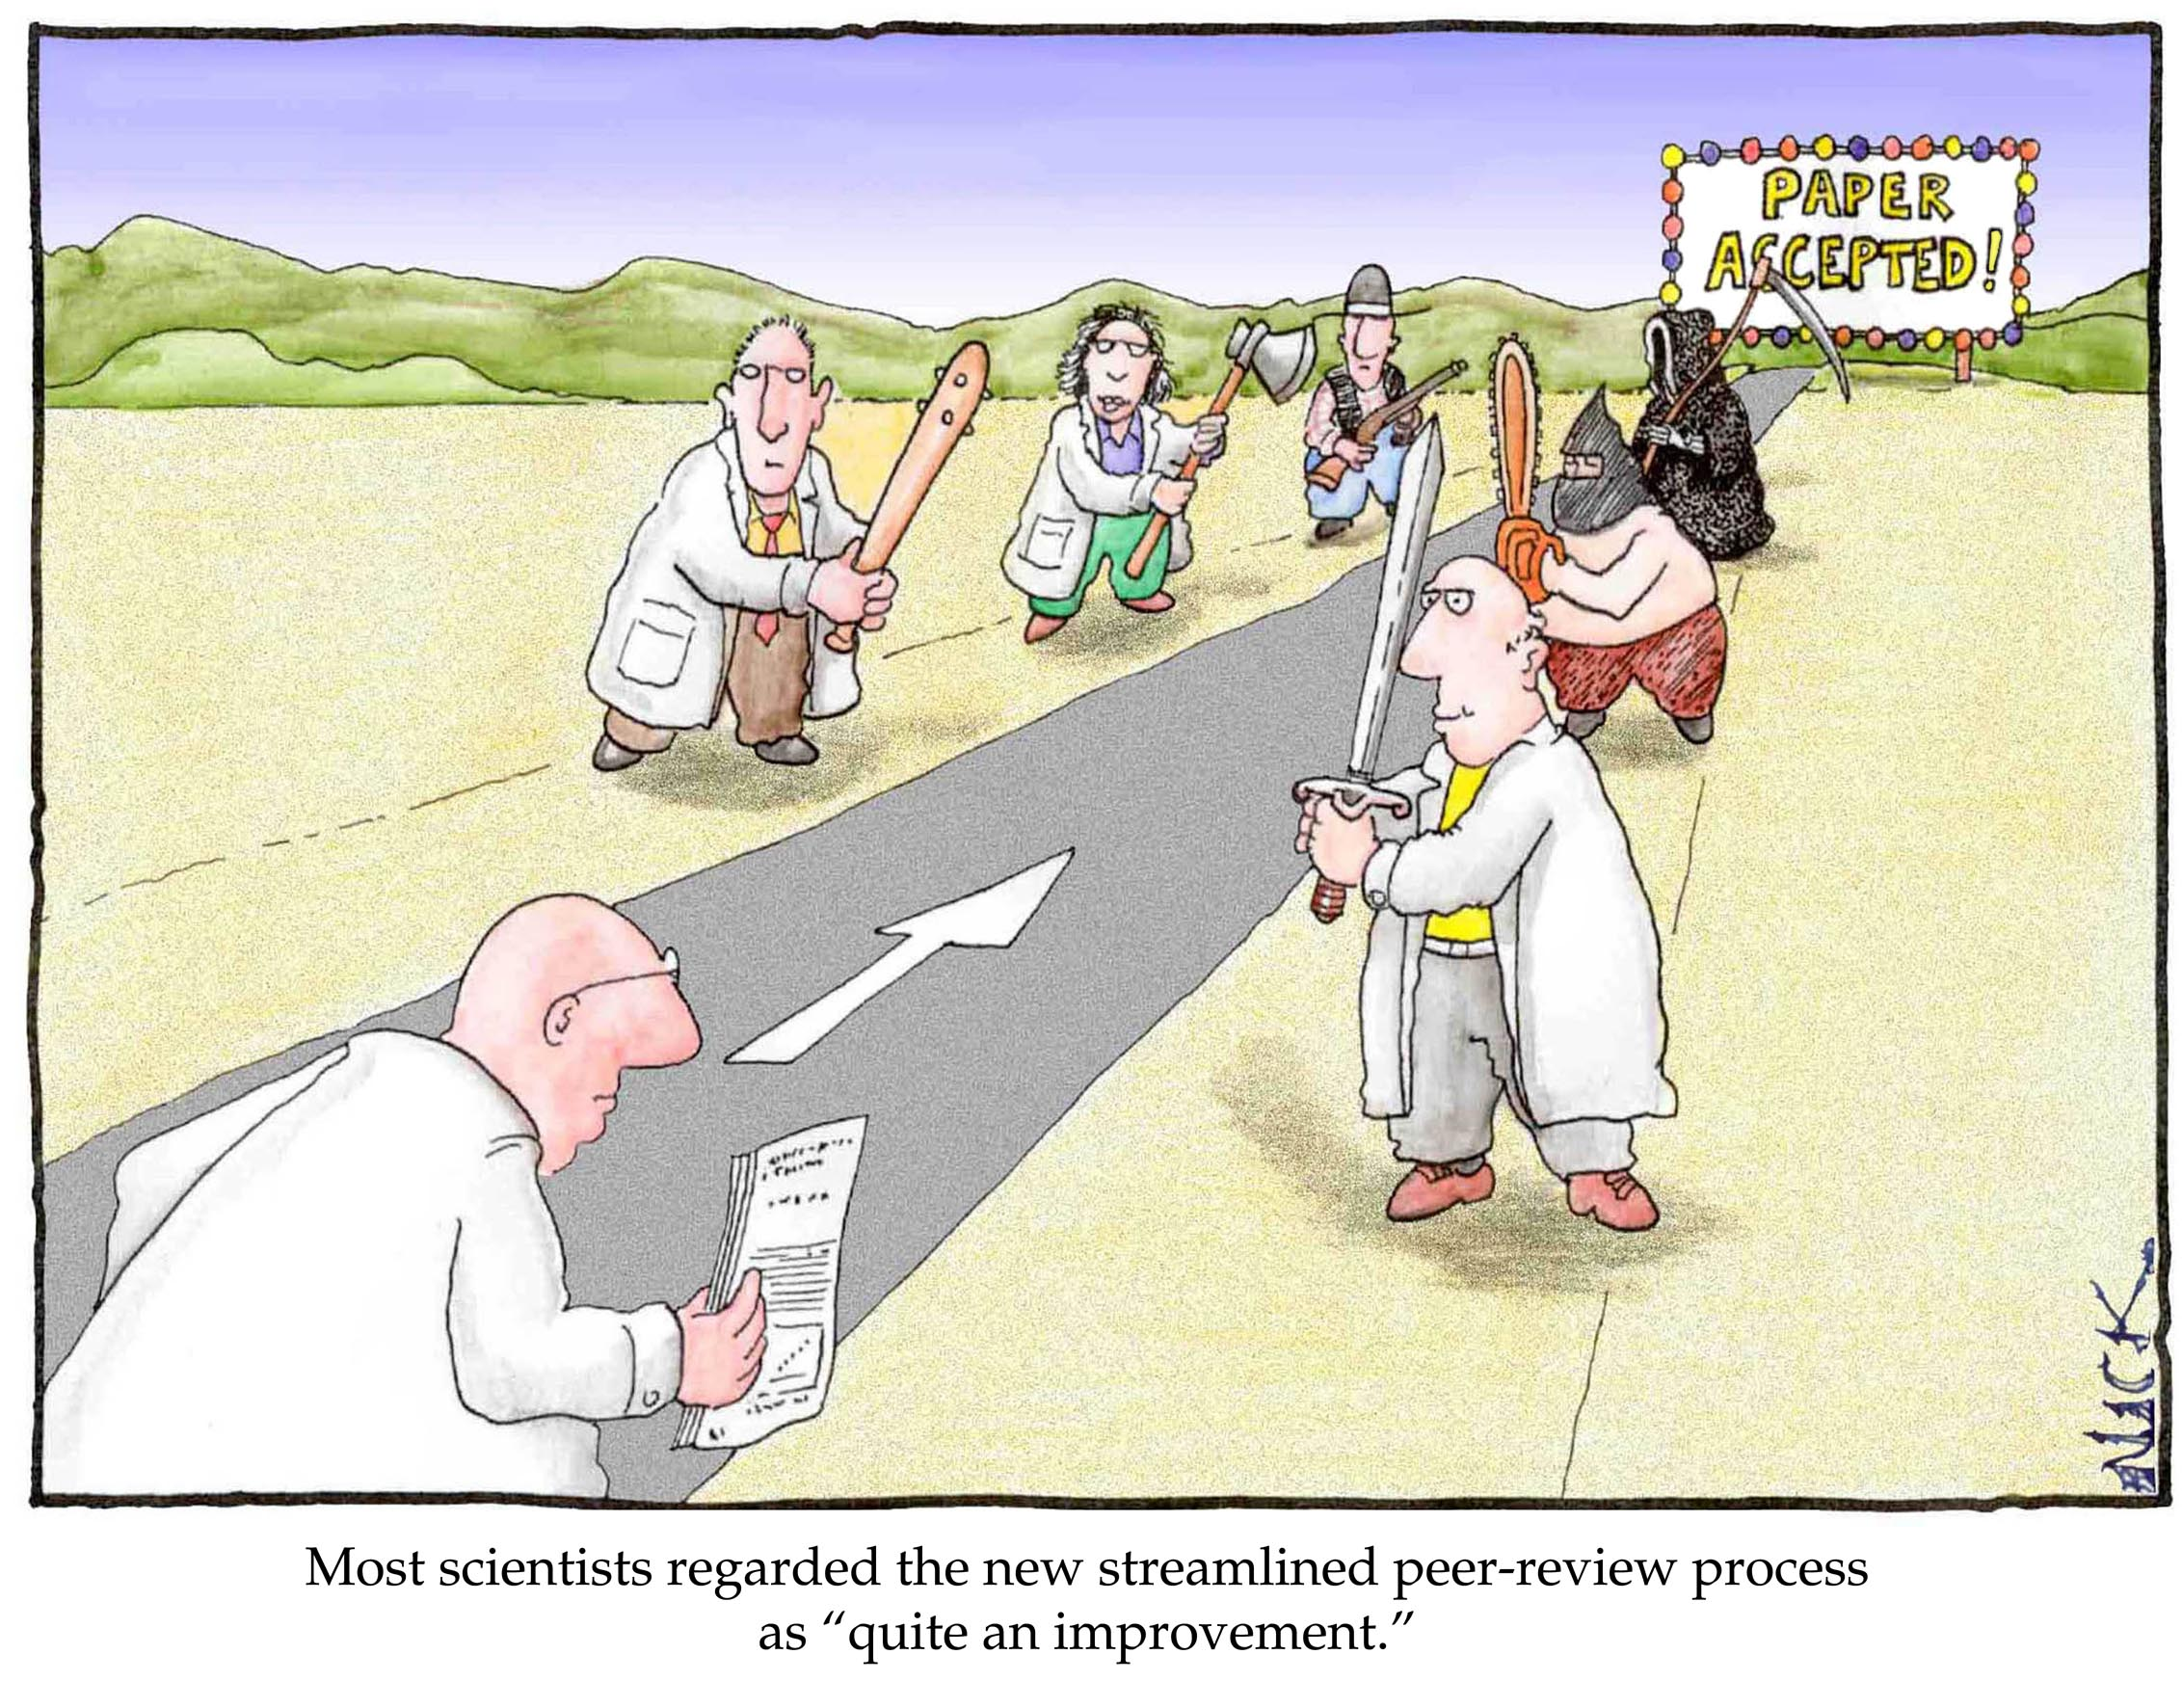
Question
A peer-reviewed article is always right?
Yes
No
Illustration: lab-initio.com/n.d. kim
Honest errors. Fermat thought the solutions of : $$2^{2^{n}}+1$$
are all prime numbers.
Euler showed this as incorrect:
$$F_{5}=2^{2^{5}}+1=4294967297=641×6700417$$
Notes:
Also ask if they know what peer review is

Slide 6
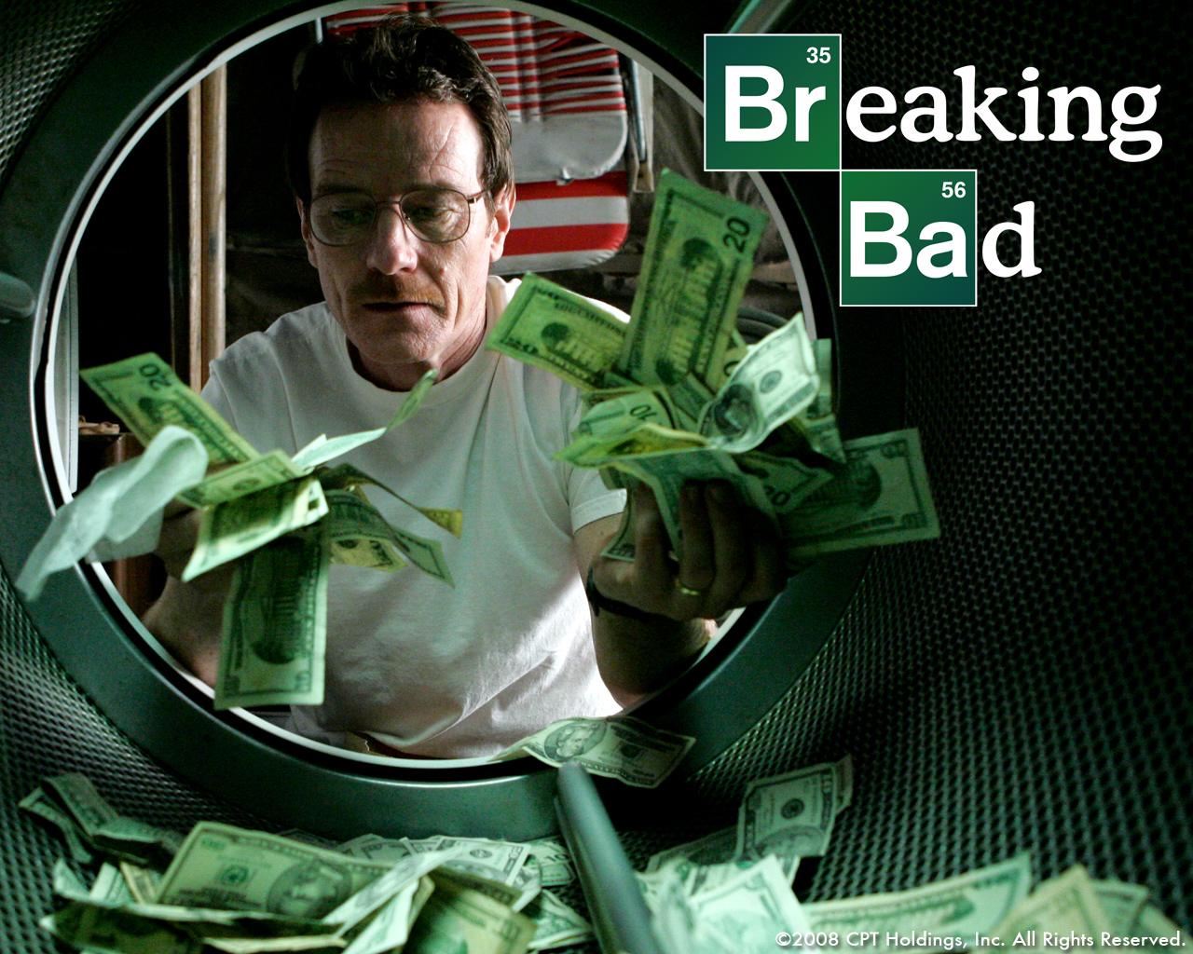
Question
I can be the next Walter White if I just know how to search?
Yes
No

Slide 7
Program
Introduction
Scholarly communication
Searching information in 5 steps
Referencing

Slide 8
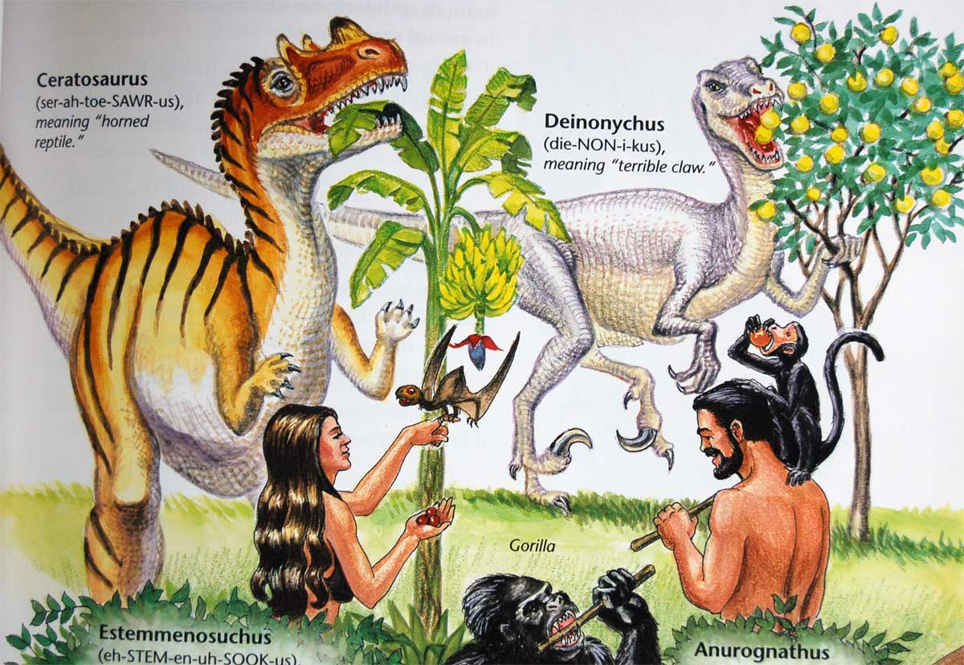
Science & communication
Non-scientific
Magazines: popular/trade (Plus Magazine, Mathematics Magazine)
Websites
Encyclopedia
Books
Scientific
Conference proceedings
Journal articles (peer-reviewed)
Books
Datasets
Wikipedia?
Dinosaurs of Eden, Ken Ham
Is any source good for Science?

Slide 9
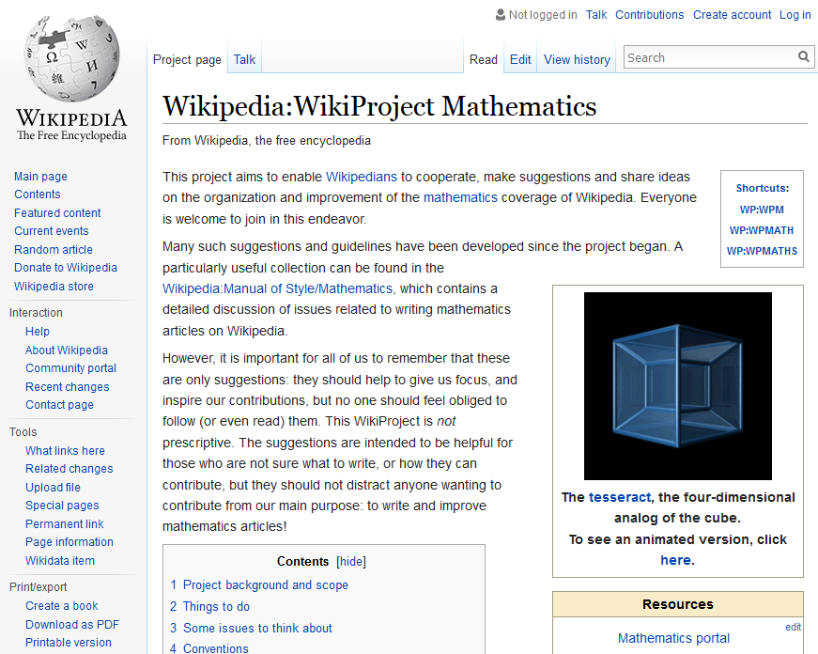
Why (not) Wikipedia?
Use Wikipedia for:
General knowledge
Getting ideas for search terms
Pointers to relevant literature
Not for:
Scientific reference
Anyone can edit!

Slide 10
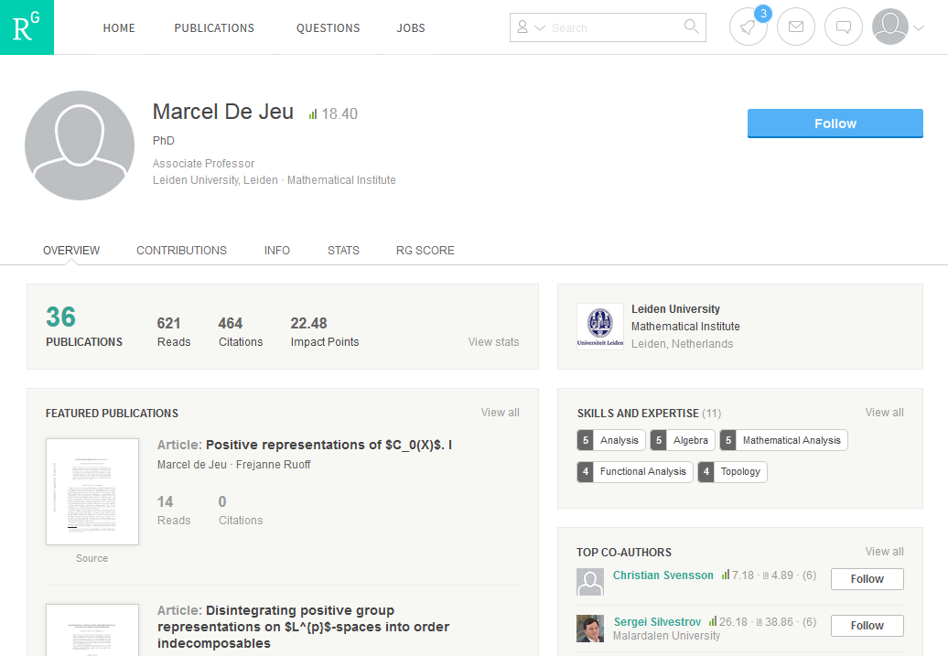
Researchgate: Social for Scientists
Follow a scientists output
Read publications
Ask questions
Get research job suggestions

Slide 11
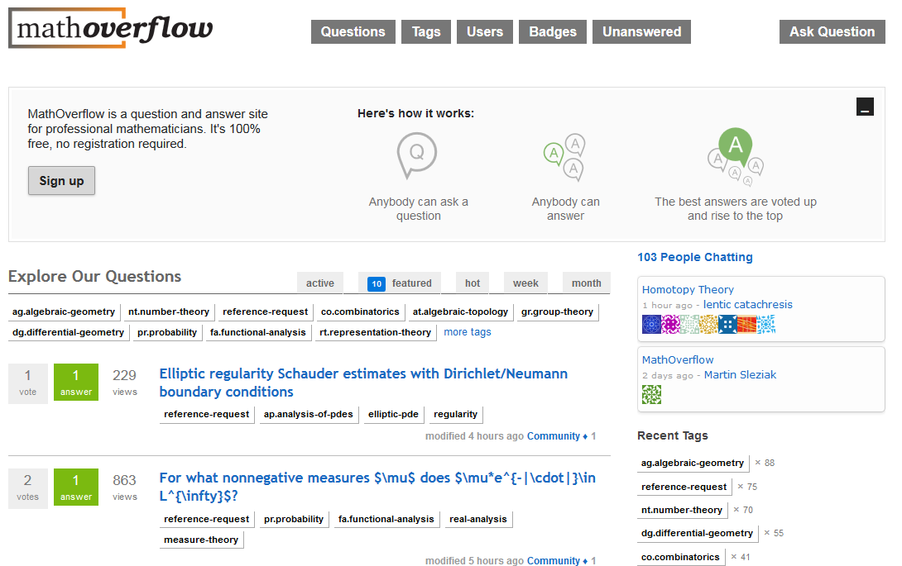
MathOverFlow: Crowdsourced Answers
Questions on mathematical topics
Quality control: up and down voting
Be nice: don’t just ask, answer as well
Can’t find the right reference for a theory, see the tag:
Reference-request

Slide 12
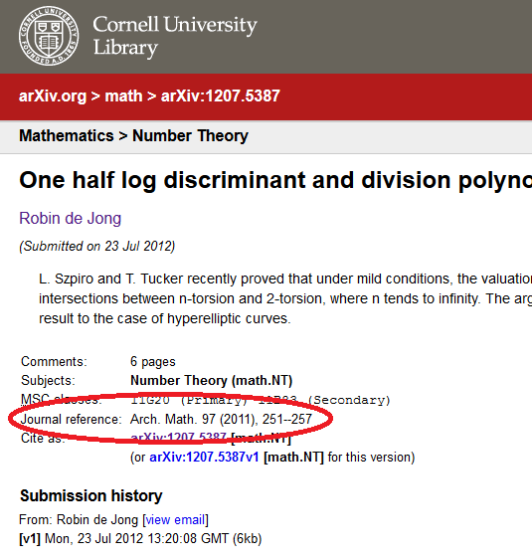
Pre-print?
Arxiv.org, a forum for professional members of the scientific community
Pros
Free
Keep up with the latest trends
Also has OA versions of published articles
Cons
Pre peer-review, little moderation
Article might change in final print
… or might never reach the final stage at all
Look for ‘journal reference’ to see if an article has been accepted.

Slide 13
Finding information in 5 steps
What information do I need?
What information resources are available?
How do I build a solid search strategy?
How do I evaluate the results?
How do I use the information in my research?
REX A.BUTCHER / SEBUN PHOTO / amanaimages / Universal Images Group

Slide 14
Step 1: Information Needs
Do a broad search to get acquainted with the topic
Decide what material is appropriate:
Books
Journal articles
Data
Nash equilibria

Slide 15
Step 2:
Step 2: Information Resources
UB Catalogue (books, databases)
Mathematical databases
MathSciNet
ZentralBlatt MATH
Project Euclid
When: looking for mathematical publications
Scientific databases
Arxiv.org (pre-print physics, mathematics and computer sciences)
Eric (education)
Google Scholar (general)
Web of Science (general)
When: looking for articles on mathematics and its applications
Collections/vendors
ACM
IEEE Computer Society Digital Library
SIAM
SpringerLink e-books
Turpion
Etc.
When: looking for a specific book/book collection

Slide 16
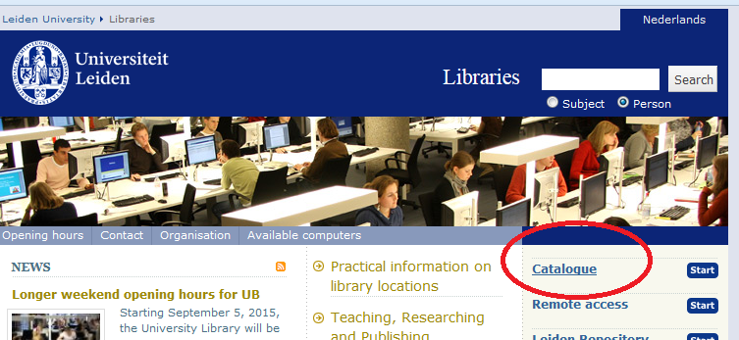
Step 2: Information Resources
Use the Catalogue as starting point
Always ‘Sign In’ with ULCN account
Books: ‘Leiden Collections’
Find Database (Web of Science, Google Scholar, etc.)
Find e-Journals
Do the Catalogue Tutorial to get started

Slide 17
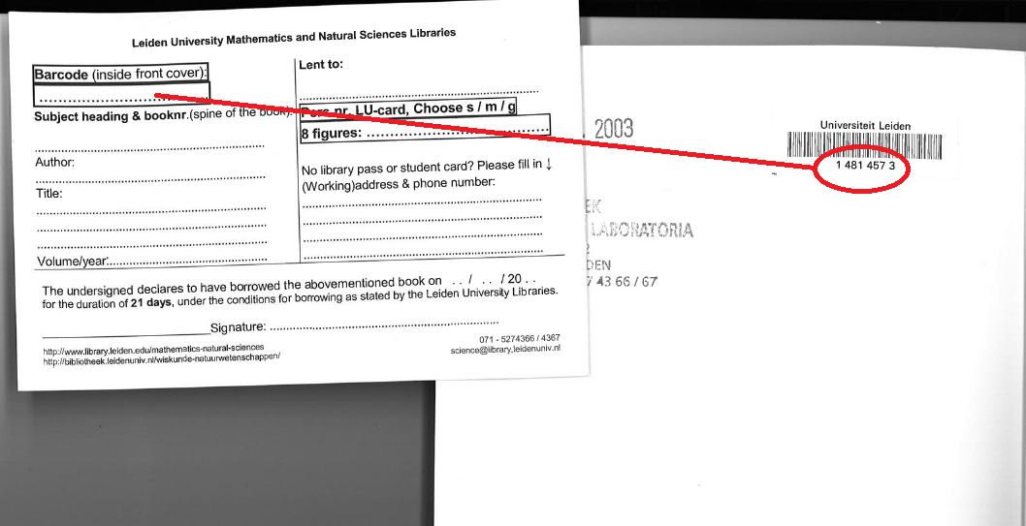
Step 2: Information Resources - Books
Snellius: always use the lending form
Fill in:
Student number
Barcode
Spine/body number (MSC + book number)
Etc.
Notes:
Zoeken in Catalogus
Author: Einstein
Ook bijzondere collecties, e-books

Slide 18
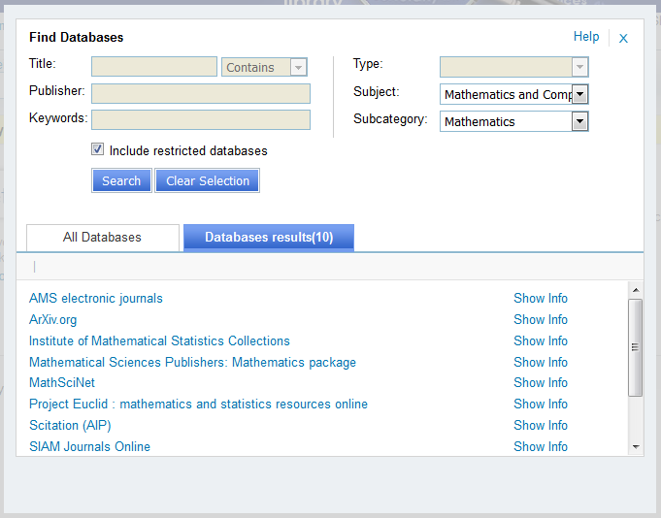
Databases
Use ‘Find Databases’ in Catalogue
Sign in to access at home

Slide 19
Peculiarities of Mathematical Databases
 | MathSciNet | Web of Science
Review | Usually a comment or short abstract of the publication | Overview of current research on a specific research subject. In mathematics look for books to get more similar content.
Classification | Mathematical Subject Classification | Broad subject areas such as statistics or applied mathematics
Impact | MCQ – based upon citations from mathematical journals only | Impact Factor – based upon all citations. For example also from applied fields such as chemistry.
Material | Many books, check catalogue as well as SFX | Mostly points to papers
Language | English, French, German, etc. | Abstract and title usually translated to English!

Slide 20
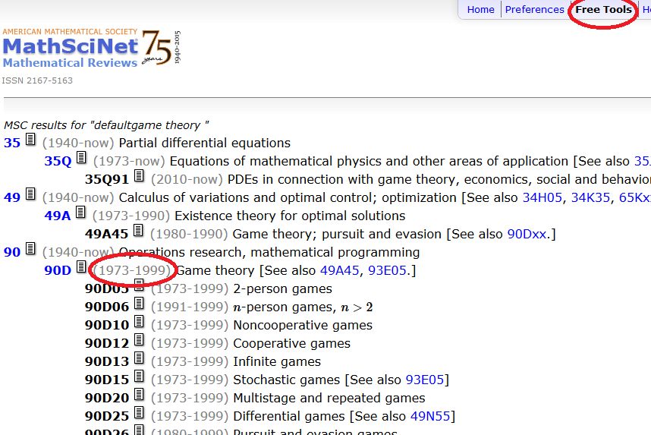
Mathematical Databases - MSC
MSC: Mathematics Subject Classification
Classification in MathSciNet, Zentralblatt MATH, Arxiv and Snellius library!
MathSciNet: Free Tools
http://www.ams.org/msc
Tips:
Use hierarchy
Check the date!

Slide 21
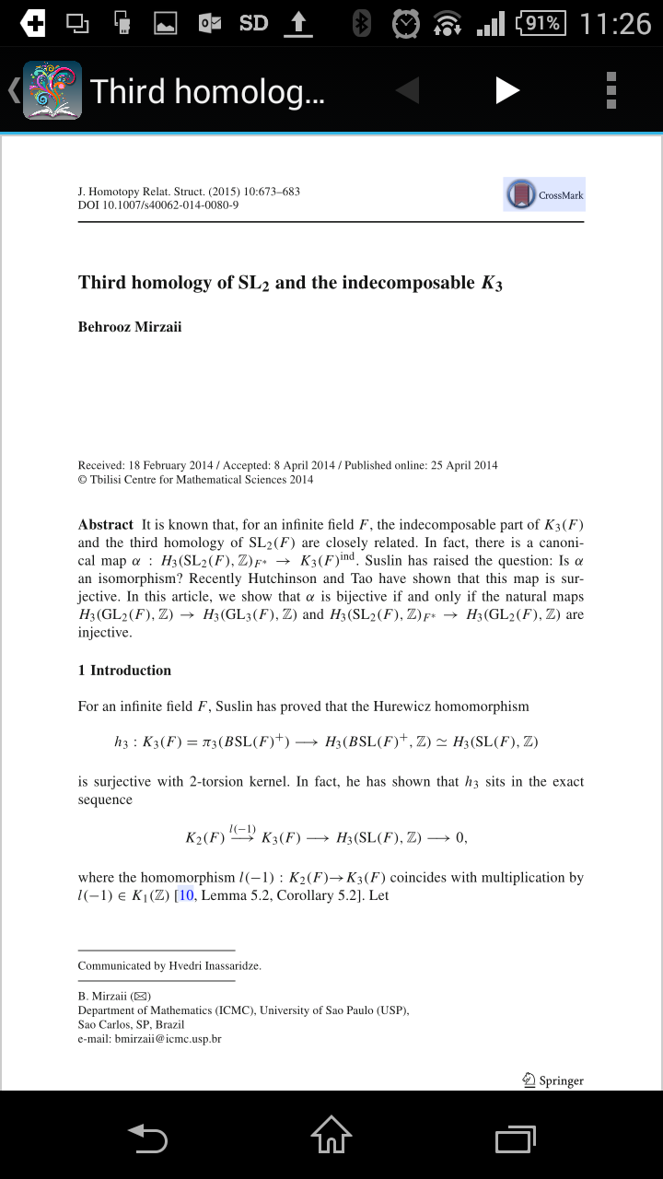
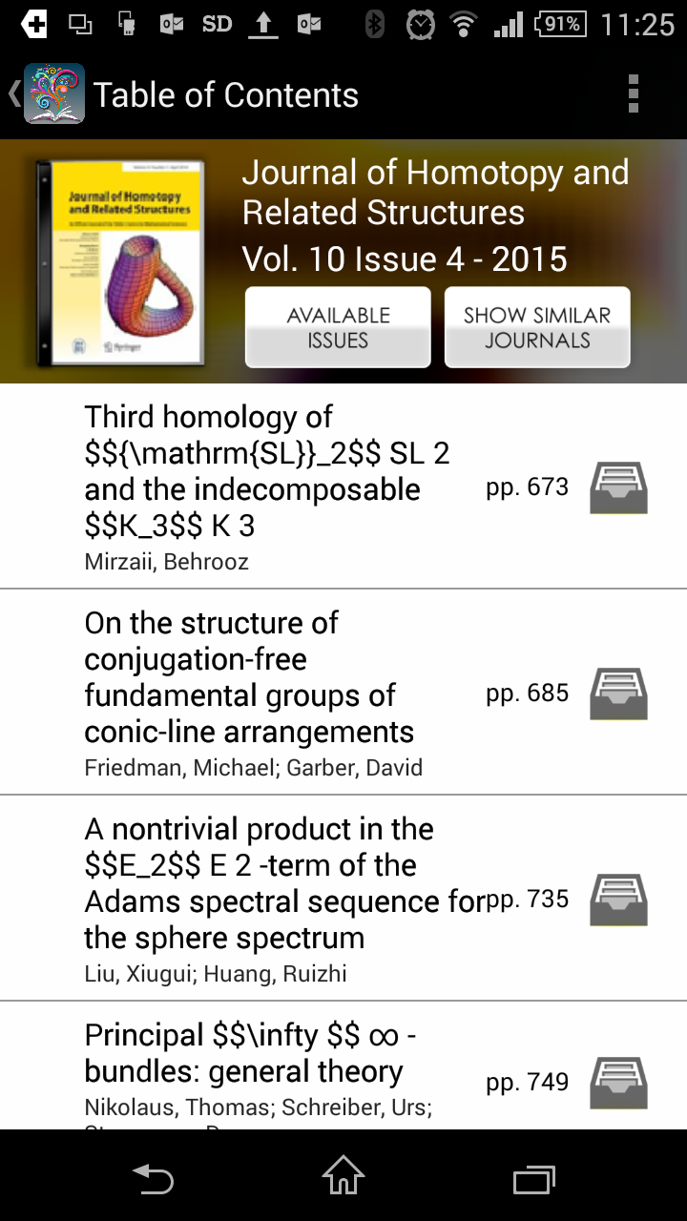
Step 2: Information Resources - Journals
Keep up with the latest trends on your topic by following specific journals.
Download Browzine on iOS or Android, login with your ULCN-account.

Slide 22
Step 3: Search Strategy
Original Research is:
Go where no one has gone before
Builds upon existing scientific foundations
Information overload
Strategy: define what you are looking for
Search efficiently and effectively
ReSearch

Slide 23
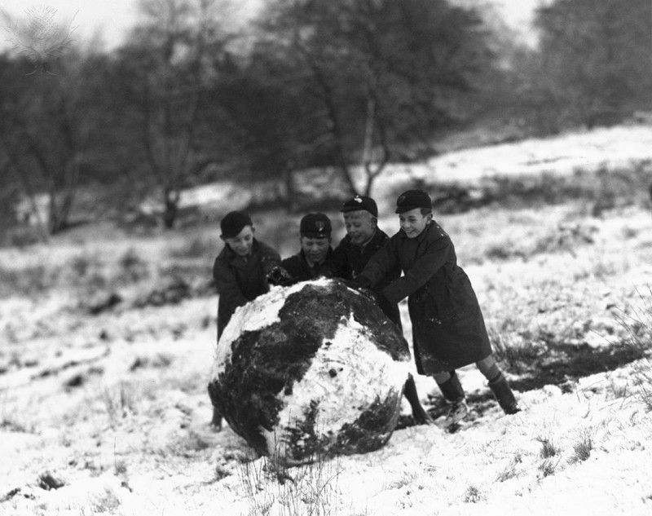
Step 3: Search Strategy – Snowball/Citations
Starting point:
Excellent article
Book
Search engines:
Google Scholar
Web of Science
MathSciNet
Zentralblatt MATH
Science and Society Museum/ Universal Images Group

Slide 24
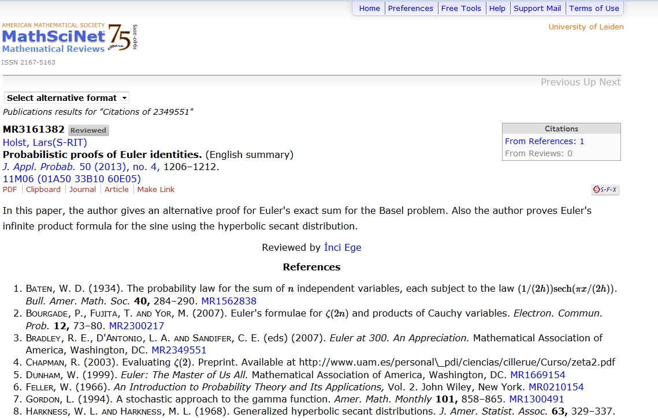
Step 3: Search Strategy – MathSciNet
Citation Database
American Mathematical Society
3 million+ references
Reviews
Search within references
Filter on
MSC
Publication type
Author

Slide 25
MathSciNet
Notes:
Open MathSciNet
Basic search. Eerst op Nash zelf of op Equilibrium Points in n-Person Games
Search for Supermarket and profits
Check out classifications
End up at 91B42
Check out popular publications there

Slide 26
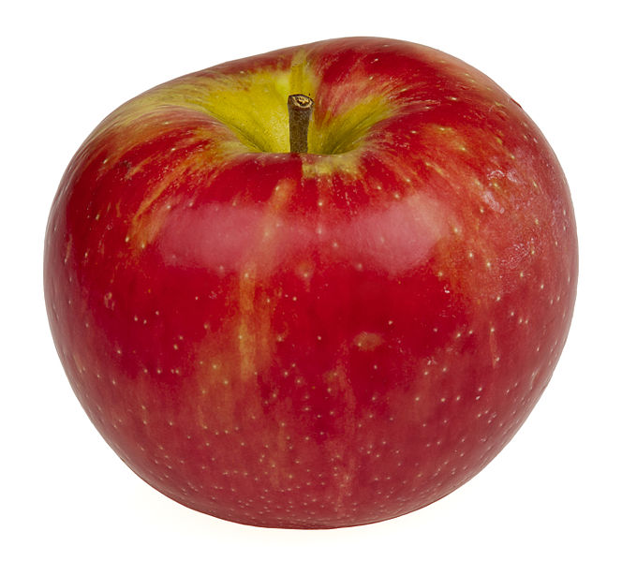
Step 3: Search Strategy – Formulating
Be specific
Ask questions:
What? – Nash Equilibria
Who? –
Why? – Want to discover how to make people spend in my supermarket
How? – By changing the prizing
When? – Not relevant
Where? – in the supermarket
Formulate as topic or question
Example:
How can I maximize my supermarket profits using Nash equilibria?
OR

Slide 27
Step 3: Search Strategy – Search Tools
First split up your question in concepts
Use many synonyms (from broad searches, www.thesaurus.com, etc.)
Use different languages! (tip: Wikipedia in different languages, database Van Dale)
How can I maximize my supermarket profits using Nash equilibria?
Concept | Synonym 1 | Synonym 2
Nash equilibria | Équilibre de Nash
Profit
Supermarket

Slide 28
Step 3: Search Strategy – Search Tools
Use wildcards. They are database specific. For Web of Science:
$ = zero or one (colo$r => colour, color)
? = one (m?n => man, men)
* = zero or more (carbon* => carbon, carbonate)
MathSciNet and Zentralblatt MATH just have * for all differences!
“Nash equilibri*” => “Nash equilibria” / “Nash equilibrium”

Slide 29
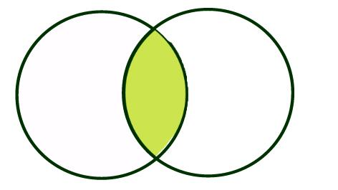
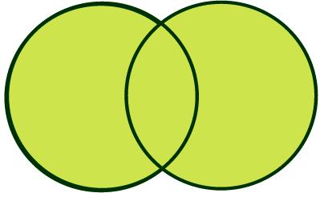
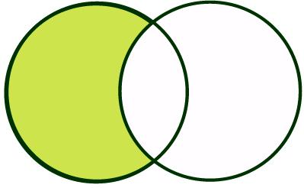
Step 3: Search Strategy – Search Tools
Couple your synonyms and concepts with booleans:
AND | OR | NOT
Concept | Synonym 1
Nash equilibria
Profit | Discount
Supermarket | Retail
OR
AND / NOT
“Nash equilibri*” AND (profit OR discount) AND (supermarket OR retail) “Nash equilibri*” & (profit | discount) & (supermarket | retail)

Slide 30
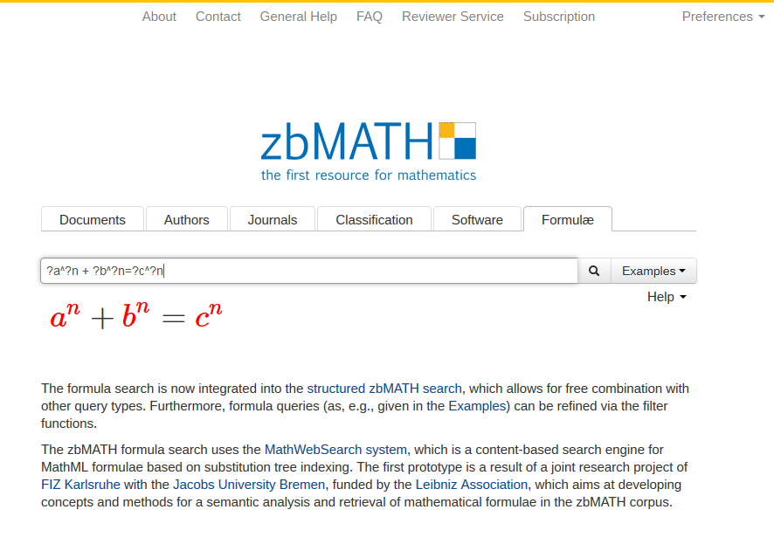
Step 3: Search – Zentralblatt MATH
Citation Database
3 million+ references
Reviews (from Zentrallblatt)
European – oldest database
Filter on
MSC
Publication type
Author
Formula!

Slide 31
Step 3: Search – Zentralblatt MATH
Notes:
Show them around the interface
Notice differences
Indicate filters

Slide 32
Step 4: Evaluating information
Read the abstracts and titles of the first pages
Relevance to research question
Age of the article
Is the journal peer-reviewed?
Not relevant, too few or too many?
Adjust your search!

Slide 33
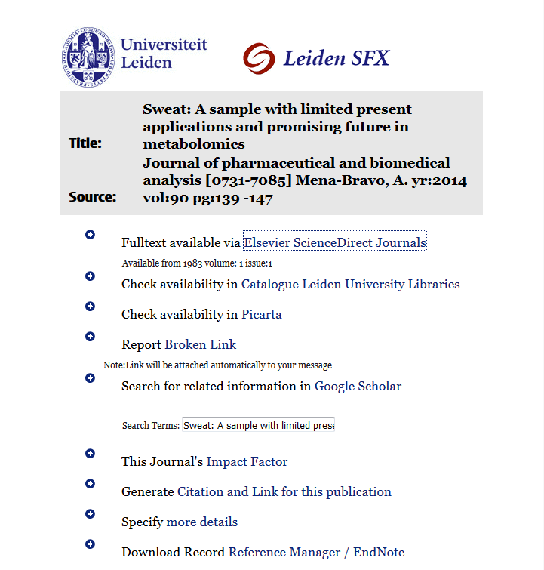
Step 5: Using Information - fulltext
Download the articles via SFX
Lookup the book in the Library
UBL has no access?
Search for the article on Google Scholar
Request from author
Request a book or article we don’t have: Inter Library Loan
Is a printed version available?

Slide 34
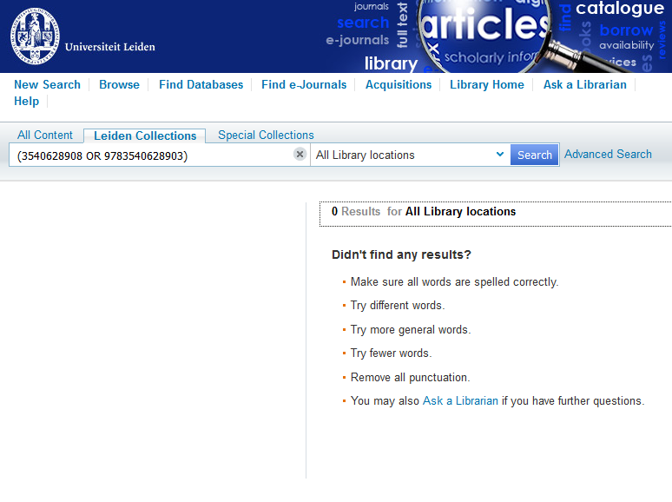
Step 5: Using Information - Problems
SFX for books in MathSciNet and Zentralblatt MATH:
Based on isbn
Try searching on title and author in catalogue
Check Google Scholar / Google Books
Try searching specific vendor database:
ACM
SpringerLink
SIAM

Slide 35
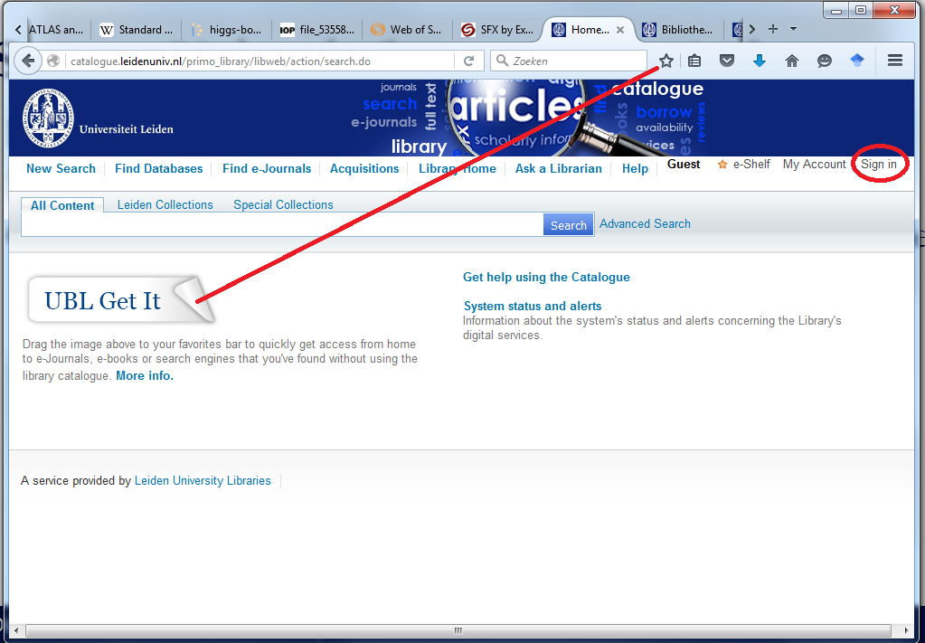
Step 5: Using information – At home
Proxy access: sign in to http://catalogue.leidenuniv.nl
Bookmark UBL Get IT
Google Scholar: Settings -> Library Links -> Universiteit Leiden

Slide 36
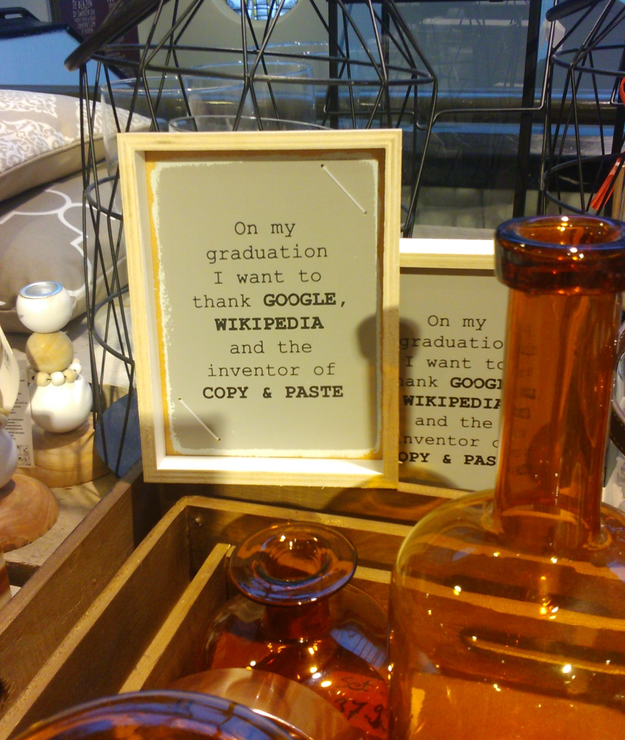
Step 5: Using Information
When citing:
Between quotes for literal citation
Paraphrase – in your own words
Always attribute
Websites are no exception
Turnitin software checks for plagiarism
Why?

Slide 37
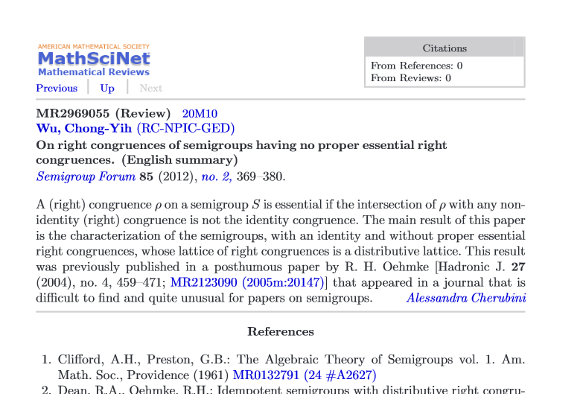
Do your research
Papers can be retracted if you did not do a proper literature search and gave due credits!
Google couldn’t find it is no excuse!
www.retractionwatch.com

Slide 38
Step 5: Using information - referencing
Venkatesan Guruswami et al. 2005. On profit-maximizing envy-free pricing. In Proceedings of the sixteenth annual ACM-SIAM symposium on discrete algorithms, SODA 2005, Vancouver, BC, Canada, January 23--25, 2005. New York, NY: ACM Press, 1164–1173.
1. Guruswami, V. et al. in Proceedings of the sixteenth annual ACM-SIAM symposium on discrete algorithms, SODA 2005, Vancouver, BC, Canada, January 23--25, 2005. 1164–1173 (New York, NY: ACM Press, 2005).
1. Guruswami, V., McSherry, F., Kempe, D., Kenyon, C., Hartline, J.D., Karlin, A.R., Kempe, D., Kenyon, C., McSherry, F.: On profit-maximizing envy-free pricing. In: Proceedings of the sixteenth annual ACM-SIAM symposium on discrete algorithms, SODA 2005, Vancouver, BC, Canada, January 23--25, 2005. pp. 1164–1173. New York, NY: ACM Press (2005).
Notes:
All the same: what is the journal title
Quickest way to get the article?

Slide 39
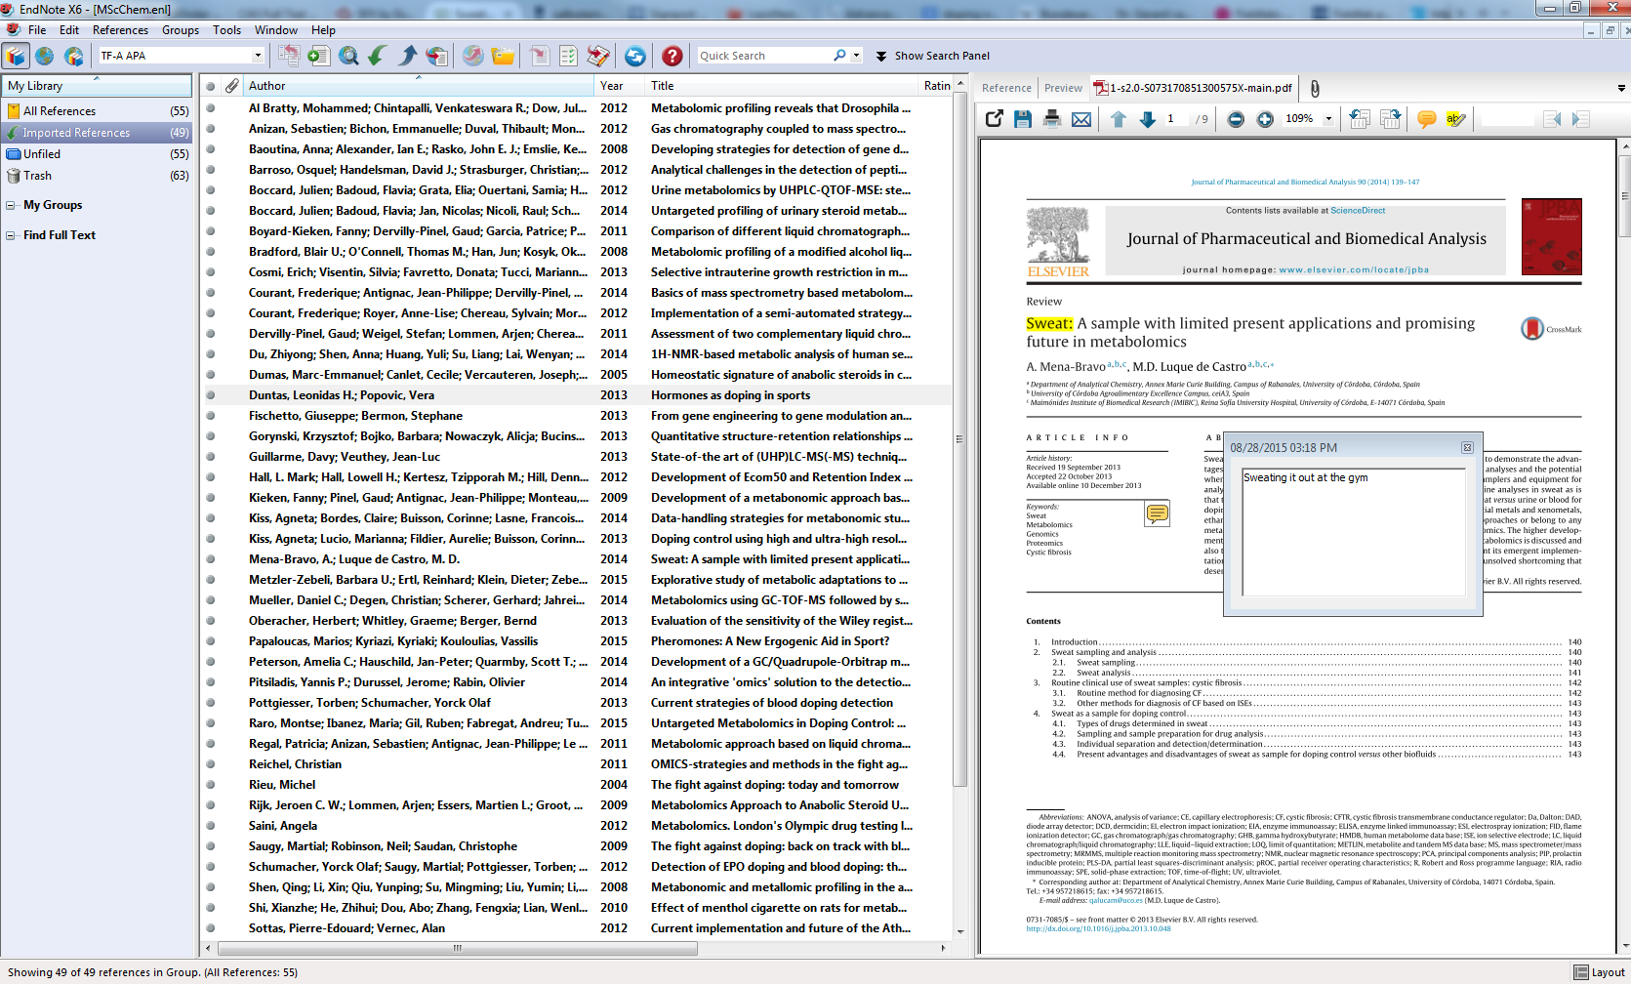
Step 5: Using Information - Referencing
Reference Management:
Keep track
Annotate legibly
Insert citations in correct format
Share literature
Managers:
EndNote, Mendeley, Zotero
Do the tutorial on citing

Slide 40
Assignments
Do the exercises provided. The subject librarian will send the answers, some tips and tricks on March 2.
Hand in the evaluation form

Slide 41
Questions? R.m.de.jong@library.leidenuniv.nl

Slide 42
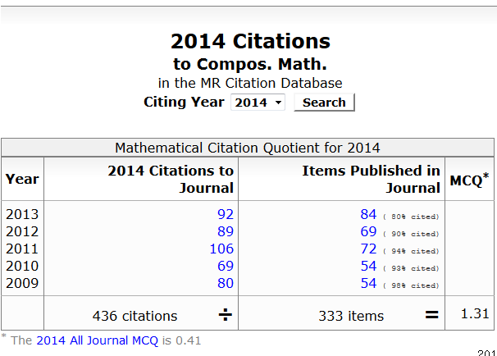
MCQ

